Slide 1
GroceryMind List food, stay fresh, reduce waste
Presented BY:
PRUTHVI PATel (200509419)
Poojan Patel (200518202)

Slide 2
UN SDG Focus
SDG 12 – Responsible Consumption and Production
GroceryMind directly supports United Nations Sustainable Development Goal 12, which aims to ensure responsible consumption and production patterns. This SDG explains the importance of reducing food waste, improving efficiency in resource use, and encouraging more mindful behaviors at all levels of society—from producers to households.
Why SDG 12 Is the Heart of GroceryMind
Every year, over 1.3 billion tons of food is wasted globally, even as hundreds of millions of people remain food insecure. This crisis has massive:
Economic impact
Environmental impact
Social impact

Slide 3
Community Orientation
During our initial research and analysis using the Community Characteristics & Orientation Framework, we identified our target user base as belonging to a “Growing & Restless” stage of the community lifecycle. These users were:
Already using basic tools (e.g., notepads, to-do apps, calendar reminders)
Interested in managing their groceries better but lacked integrated solutions
Tech-aware, but not always tech-savvy preferring intuitive and low-effort tools

Slide 4
Technology Configuration Inventory Insights
We evaluated the current technology habits and capabilities of the community using the Technology Configuration Inventory method. Key findings included:
Most users had access to smartphones and internet, but some used older or low-performance devices
Common usage of tools like:
Google Keep or Apple Notes for grocery tracking
Reminders app or calendar for expiry alerts
Separate apps for meal planning or donation awareness
There was no central system that combined these elements in a streamlined way

Slide 5
Similar applications and their gaps
Out of Milk – This app provides basic shopping list and inventory tracking features. It offers a simple interface where users can categorize their grocery items. However, Out of Milk lacks automated expiry reminders and real-time inventory updates, requiring users to manually update item details.
NoWaste – This app specializes in expiry date tracking and allows users to log item details such as purchase dates, expiry dates, and storage locations. While NoWaste effectively tracks expiration, it relies on manual data entry, making it prone to user oversight and inefficiencies.
FridgePal – Known for its inventory management system, FridgePal allows users to categorize food items and set reminders for expiring products. However, it lacks group collaboration features, making it less suitable for families or shared households looking to manage groceries collectively.

Slide 6
Identified gaps
Lack of Integration: Users often rely on separate apps for inventory tracking, expiry reminders, and grocery list generation.
Limited Automation: Most solutions require manual updates, reducing efficiency and increasing the risk of expired food.
Absence of Group Collaboration: Few platforms support shared inventory management, essential for families or shared households.
Inadequate Meal Planning Support: Few solutions provide dynamic meal suggestions based on expiring ingredients.

Slide 7
Grocerymind’s unique approaches
Integrated Grocery Management (all in one app)
Automated expiry notifications (1, 3, or 7 days)
Categorized inventory (Fruits, Vegetables, Dairy, etc.)
Shared shopping lists for roommates or families
Smart meal suggestions based on inventory

Slide 8
Technical design & development overview
Tech Stack:
Layer | Tech Used
Frontend | React/React Native
Backend | Node.js
Notifications | Expo Push notifications
Database | MongoDB
Hosting/API | Render / Firebase APIs

Slide 9
Technical design & development overview
Pros:
Scalability and flexibility.
Easy integration with Open Food Facts API.
Real-time notifications via Firebase Cloud Messaging.
Cons:
Initial challenges in configuring backend/frontend communication.

Slide 10
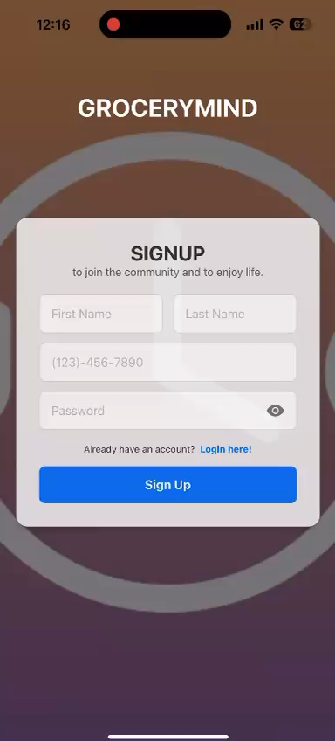

Demo https://youtu.be/4tu80Z3Za7A

Slide 11
Lecture Concepts Applied
Digital Habitats (L02, L04): Combined multiple tools into one habitat
Technology Stewardship (L03): Mapped tech config to user needs
Community Orientations (L05): Designed async tools for individual/group use
Creativity & Media Use (L10): Clean interface, friendly tone, simple flows
Change & Product Quality (L11): MVP-first focus, feedback loop integration

Slide 12
Future Work
Barcode Scanning
Partnerships with local grocery stores and food banks
Food-Based Expiry Suggestions

Slide 13
Team Reflection & lessons learned
Proud of: Addressing a real-world problem aligned with UN SDG goals.
Learned: Scoping matters, documentation helps, user feedback.
Successes: Delivered on the core vision
Challenges: Notifications took longer, user testing came late
Next time: Start testing earlier, reserve time for polish
Future use: Will carry lessons in sustainable design, community-first thinking, and modular app architecture

Slide 14
Team Reflection & lessons learned
Like: Addressing food waste felt impactful.
Dislike: Time constraints limited feature development.
learnt about ourselves: Improved problem-solving and adaptability skills.

Slide 15
References
Food and Agriculture Organization of the United Nations. (2013). Food wastage footprint: Impacts on natural resources. FAO. https://www.fao.org/3/i3347e/i3347e.pdf
United Nations. (2015). Sustainable Development Goal 12: Responsible consumption and production. UN Department of Economic and Social Affairs. https://sdgs.un.org/goals/goal12
Statista Research Department. (2023). Global food waste statistics & facts. Statista. https://www.statista.com/topics/8763/global-food-waste/
NoWaste App. (2024). NoWaste - Reduce food waste, save money. https://www.nowasteapp.com/
Out of Milk. (2024). Out of Milk - Shopping List, Pantry List, To-Do. https://www.outofmilk.com/
Open Food Facts. (2024). Open Food Facts - Open database of food products. https://world.openfoodfacts.org/

Slide 16

Thank you!

